Slide 1
Tenses Revision
Let’s go!

Slide 2
Present Continuous
Happening NOW, at the time of speaking or a short period of time
I am doing an exercise right now but my friend isn’t studying. He is playing video games.
am / are / is + -ing

Slide 3
Remember:
Play → playing Do → doing
But …. !!!
Dance → dancing
Swim → swimming Run → running Hop → hopping
Look
right now
at the moment
this week / this year / this weekend etc.

Slide 4
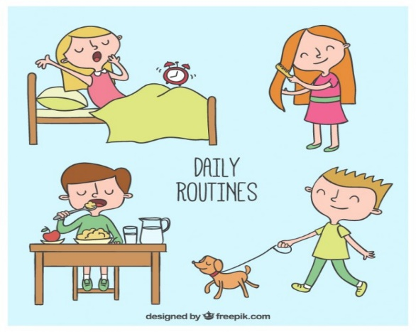
Present Simple
our daily routine, habits
My friend and I go to school on weekdays but we don’t have lessons at the weekend.
general truths (γενικές αλήθειες)
The sun rises every morning.
timetables (προγράμματα)
→ Our school doesn’t finish at 1:05 like other schools. It finishes at 4:00.

Slide 5
I go to school.
You go to school.
He goes to school.
She goes to school.
It goes to school.
We go to school.
You go to school.
They go to school.
He / she / it
watch – watches
-ch, -sh, -o, -ss → -es
→ Study - studies
I don’t go to school.
You don’t go to school.
He doesn’t go to school.
She doesn’t go to school.
It doesn’t go to school.
We don’t go to school.
You don’t go to school.
They don’t go to school.
doesn’t + απλό ρήμα
Do you go to school?
Yes, I do.
No, I don’t.
Does he go to school?
Yes, he does.
No, he doesn’t.

Slide 6
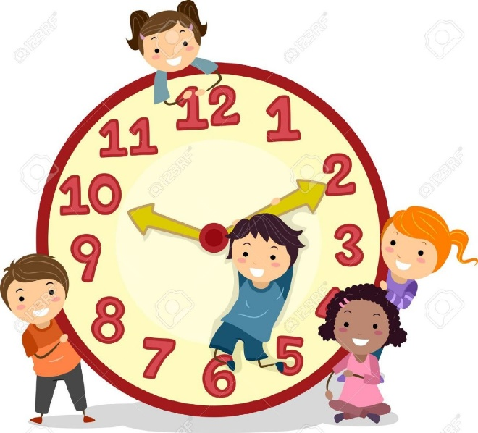
Adverbs of frequency
I always do my homework in the afternoon.
I often tidy my bedroom at the weekend.
I usually help my mum with housework.
I sometimes go to the cinema with my best friend.
I never play tennis. I hate it!

Slide 7
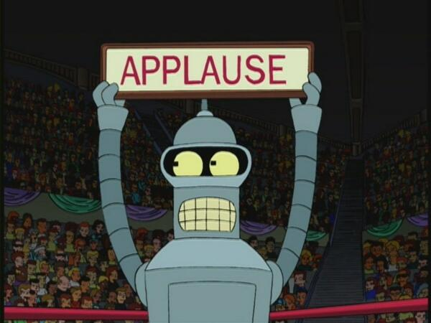
Are you ready to move on?
Let’s go…

Slide 8
Past Simple
PAST NOW
Play – played V2 (irregular verbs)
Dance – danced go - went
Talk – talked be – was/were
→ We danced a lot at the party → Last night, I went to my aunt’s house.
yesterday.

Slide 9
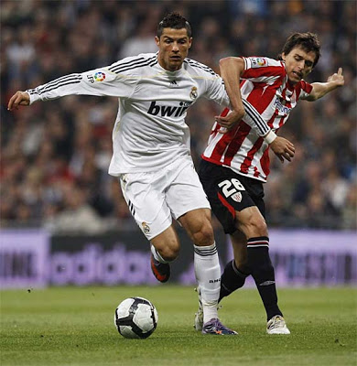
Negative Question
I didn’t play football Did you play …?
with my friend yesterday. No, I didn’t.

Slide 10
TIME EXPRESSIONS
yesterday
in 2019
in 1987
last week
last night
last year
3 days ago
20 minutes ago
10 years ago

Slide 11
PAST PROGRESSIVE
I was watching my favourite TV series at 5 o’clock yesterday.
5 o’clock
6 o’clock
was/were + -ing

Slide 12
Okay, it’s your turn now!

Slide 13
doesn’t watch
1. Lucy ……………………………… (not watch) TV in the afternoon.
is drawing
2. At the moment, Susan ……………………………… (draw) flowers.
was eating
3. My mother …………………………… (eat) when my dad ………………………….. (come) home.
came
Did
4. …………… they travel to Paris last year?

